Slide 1
Lecture 1: Introduction to data structures and algorithms
University of Technology and Engineering
Vietnam National University Hanoi

Slide 2
Outline
Data structures and algorithms
Industrial problems
Data types
Abstract data structures
Problem description

Slide 3
Computer programs
What is a computer program?
A computer program is a set of instructions that perform specific tasks when executed by computers.
What is a good computer program?
Correctness
Efficiency
Simple/Understandable
Easy to change/maintain and upgrade
“Program = Algorithms + Data structures”
N. Wirth

Slide 4
Data structures?
What is a data structure?
A data structure is a particular way of storing and organizing data so that they can be used efficiently.
What is a good data structure?
Correctness (satisfy requirements)
Memory efficiency
Simple/understandable
Implementable
Standard data structures
Array
Set
Map/Dictionary

Slide 5
Algorithms?
What is an algorithm?
An algorithm is a step by step procedure to solve a problem. An algorithm can be described by nature languages (English, Vietnamese...) or programming languages (C++, Java, Python…)
Example: How to cook rice?
Step 1: Get rice
Step 2: Rinse the rice
Step 3: Put the rice and water into a rice cooker
Step 4: Turn on the rice cooker
Step 5: Check the rice when the rice cooker turns off
What is a good algorithm?
Correctness
Efficiency
Simple/understandable
Implementable

Slide 6
Example: Searching problem
Problem: Given a list of numbers sorted increasingly, describe an algorithm to check if a number k is in the list.
Naïve searching algorithm
Moving from the begin to the end of the list to check if k is in the list.
Binary search algorithm
Compare k to the number at the middle of the list:
if they are equal, finish the searching process.
if k is smaller, perform the search in the first half of the list
if k is greater, perform the search in the last half of the list

Slide 7
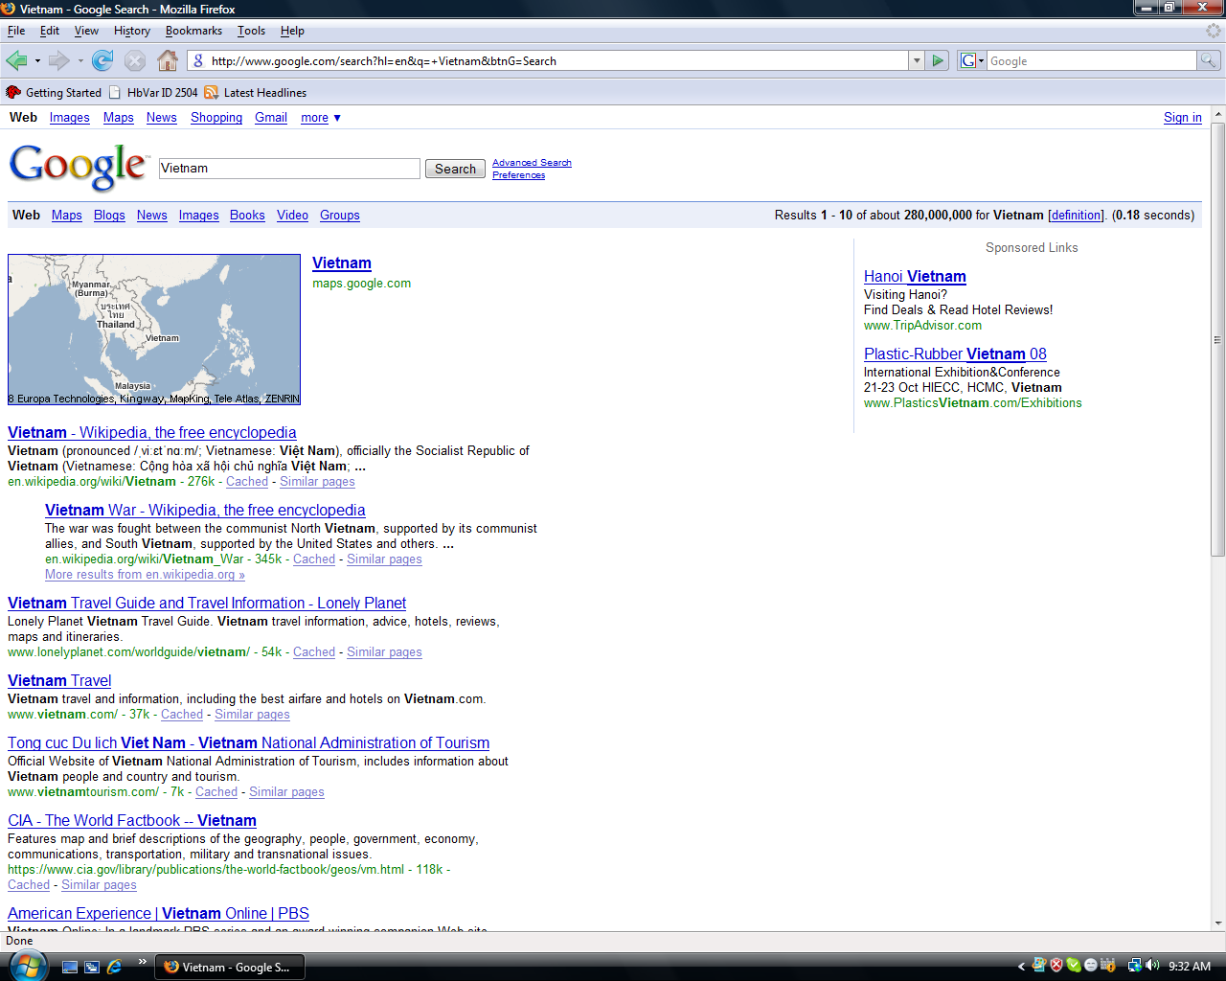
Google search

Slide 8
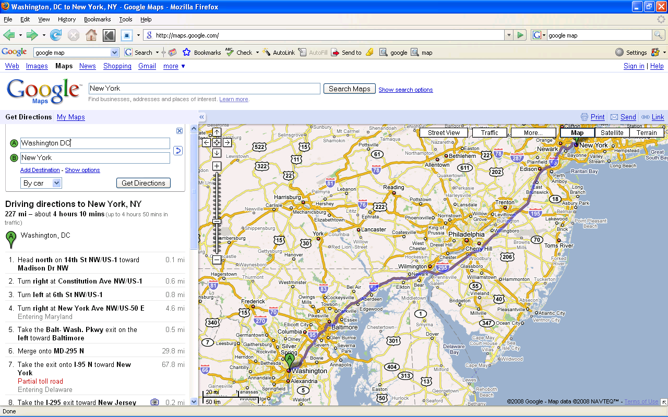
Find the shortest path (Google map)

Slide 9
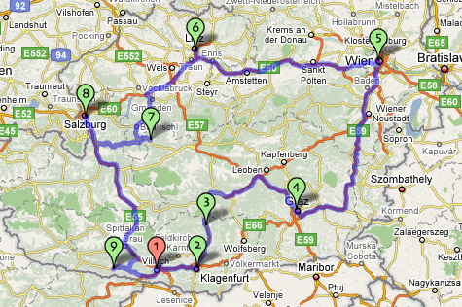
Traveling salesman problem (TSP)
A salesman needs to visit n customers at n different locations. Find the shortest path for the salesman such as he visits each location exactly once and finally returns to the start location.

Slide 10


Quiz 1: The roles of data structures and algorithms

Slide 11


Quiz 2: The roles of data structures and algorithms

Slide 12
Data types
A data type is specified by:
The range of values or the values it can hold.
Operations on values
type | range | operations
bool | true / false | and, or, not,
char | [-127, 127] | ‘<‘, ‘>’, ‘=’, ‘+’, ‘-’, ‘*’, ‘/’
int | -32,767 -> 32,767 | ‘<‘, ‘>’, ‘=’, ‘+’, ‘-’, ‘*’, ‘/’
float | ~1E-37 -> ~1E+37 | ‘<‘, ‘>’, ‘=’, ‘+’, ‘-’, ‘*’, ‘/’
double | ~1.7E-308 -> ~1.7E+308 | ‘<‘, ‘>’, ‘=’, ‘+’, ‘-’, ‘*’, ‘/’

Slide 13
Structured data types
Question: What data type to present a point on the plane?
Solution: Programming languages provide rules to define a new data type T from defined data types
Example in C++:
struct PersonType {
string name;
int age;
bool gender;
};

Slide 14
Structured data types
How to present a point on the plane?
struct PointType {
double x;
double y;
};
How to present a line on the plane?
struct LineType {
PointType start;
PointType end;
};

Slide 15
Structured data types
Define a data structure to present student information
struct StudentType {
string name;
int age;
bool gender;
}
Define a data structure to present our class information
struct ClassType{
string className;
int numberStudents;
StudentType students[100];
}

Slide 16
Range of structured data types
The range of a structured data type T is determined by the ranges of data types that are used to construct T.
Example:
struct ComplexType {
double real;
double image;
};
The range of ComplextType:
real: The range of ‘double’ type
image: The range of ‘double’ type

Slide 17
Operations on structured data types
Operations on a structured data type of a program are defined by the program.
Example:
struct ComplexType {
double real;
double image;
};
ComplexType add (const ComplexType &c1, const ComplextType &c2) {
ComplexType sum;
sum.real = c1.real + c2.real;
sumimage = c1.image + c2.image;
return sum;
}
ComplexType multiply (const ComplexType &c1, const ComplextType &c2) {
ComplexType product;
product.real = (c1.real * c2.real) – (c1.image * c2.image);
product.image = (c1.real * c2.image) + (c1.image * c2.real);
return product;
}

Slide 18
Abstract data types
Abstract components of a structured data type
Example: ComplexType
real //the real component of complex number
image //the image component of complex number
Abstract operations of a structured data type
Example: ComplexType
add (c1, c2): Add two complex numbers c1 and c2 and return their sum.
multiply (c1, c2): Multiply two complex numbers c1 and c2 and return their product.

Slide 19
Abstract data types
Abstract Student data type
Abstract data type components
ID
Name
DOB
Address
Abstract operations
initializeStudent (ID, Name, DOB, Address)
compareStudents (student1, student2)
getID (student)
getName (student)
getDOB (student)
getAddress (student)

Slide 20
Quiz 3
Abstract TEACHER data type
Abstract COMPUTER data type
Abstract RECTANGLE data type

Slide 21
Problem description
Description:
What is the nature of problem?
What questions need to be solved?
What data and constrains are given?
What results are expected?
Examples
Input: Describe the input and their specific constrains
Output: Describe the output and their specific requirements

Slide 22
Birthday cake selection
Problem: Today is Anna’s birthday and she is going to buy a birthday cake. The cake shop has many birthday cakes with different sizes. As a kid, Anna wants to pick the largest one. For example, if there are 4 birthday cakes with sizes 1, 5, 3, and 7, Anna will pick the cake with size 7. Your task is to write a program to find the largest birthday cake for Anna.
Input: Data come from file BirthdayCakes.txt as following:
The first line contains a single integer number n, denoting the number of birthday cakes at the shop (0 < n < 10000).
The second line contains n space-separated integer numbers each describes the size of one cake.
Output: Write to file BirthdayCakes.out an integer number which is the size of the largest birthday cake.
Example:
BirthdayCakes.txt BirthdayCakes.out
4 7
1 5 3 7

Slide 23
Quiz 4
Describe the problem of finding the product of two big integer numbers
Describe the problem of sorting students according to their final examinations
Describe the problem of finding the shortest path between two locations

